Slide 1
Lanterman Act as a Foundation
Training and Development
Inland Regional Center

Slide 2
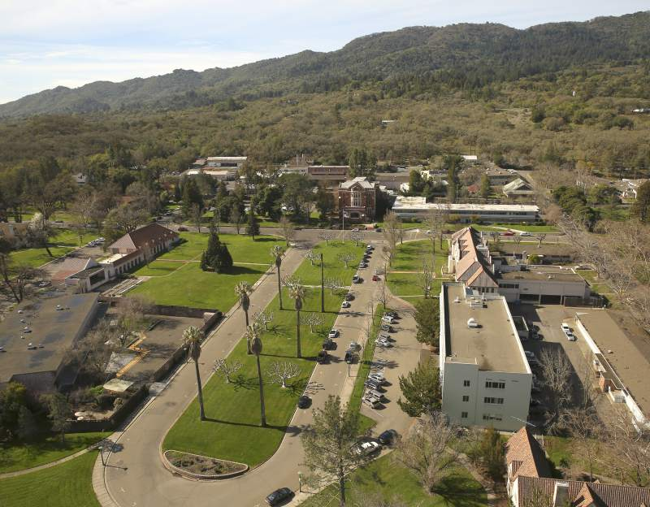
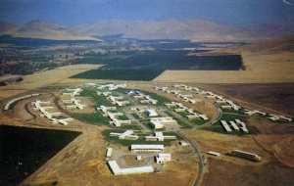
How did we get here?
Where did people with Developmental Disabilities used to go?
Why?

Slide 3
How did we get here?
1961 – JFK – “Proposed Program for National Action to Combat Mental Retardation”
1975 – became Developmentally Disabled Assistance and Bill of Rights Act 1977 – Lanterman Act, unique to California
Prior the creation of these laws
DD individuals lived at home with no supports
Were often segregated and hidden
Institutionalized in early childhood

Slide 4
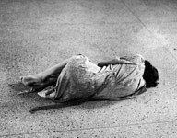
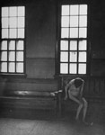
Those that were institutionalized were abandoned and forgotten about

Slide 5
Isolation

Slide 6
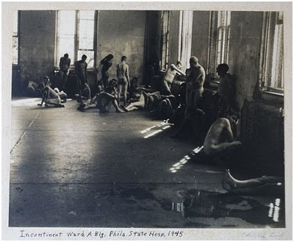
Overcrowding

Slide 7
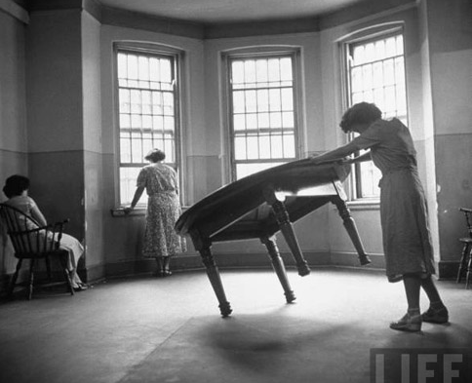
Excluded from Society

Slide 8
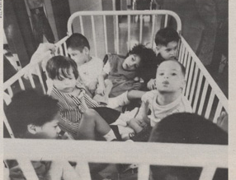
Children and Babies

Slide 9
Custodial Care and Staffing Ratio

Slide 10
How did this change?
1961 – JFK – “Proposed Program for National Action to Combat Mental Retardation”
In the 1960’S, Parents initiate the change
Increased Public and Governmental Awareness through Media Attention – G. Rivera documentary
1975 – That became: Developmentally Disabled Assistance and Bill of Rights Act 1977 – Lanterman Act was signed, unique to California
Other States’ Protections
Legislative Change: Lanterman as a springboard
IDEA

Slide 11
The Lanterman Developmental Disabilities Services Act
Signed in 1977 - most recent update:
January 2015
Expanded eligibility categories for DD individuals
Established individualized planning

Slide 12
Lanterman Act
Entitlement Program: LA 4501 (p.49-50)
Why?
The State of California accepts responsibility for individuals with developmental disabilities
Payor of Last Resort
Evidence-Based Therapies
The legislature finds that the mere existence or the delivery of services is, in itself, insufficient evidence of program effectiveness.
Specific Protections for people with Developmental Disabilities

Slide 13
Lanterman Act
Around the time of the LA
AB 691 established two pilot regional centers to serve individuals with mental retardation. These pilot regional centers were based in Los Angeles and San Francisco
Success of the pilot program led to the expansion of the Regional Center system Statewide (AB 225)
Nonprofit Private and Community-Based
Why is this system so successful?
Cost of Service

Slide 15
Lanterman Act
Requirement to use Generic Resources
Responsibility of parents
Details what the Regional Center System can and can not do
Most Importantly….
It states that: Consumers, families, conservators, and/or legal guardians MUST have a leadership role in service design
Where they live
Relationships they have
Leisure time
Educational and vocational opportunities
Future planning

Slide 16
Inland Regional Center
Serves 35,500+ individuals
Riverside and San Bernardino County
Largest of 21 regional centers
Core values:
independence, inclusion, and empowerment
Expected Growth
40,000 Consumers
1,000 Staff

Slide 17
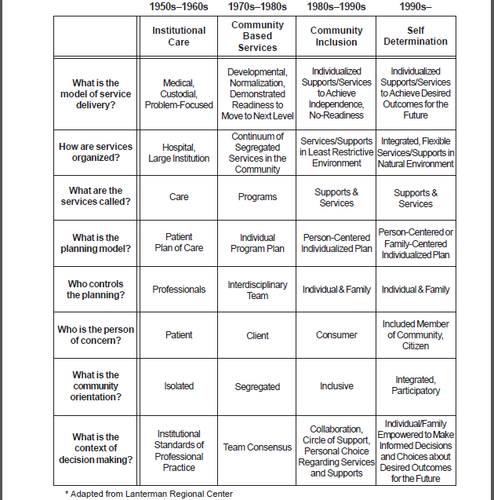

Slide 19
Lanterman Act
Who does it serve?
What does it provide?
How does it determine what we do as Regional Center employees?

Slide 20
Qualifying Conditions
Intellectual Disability
Autism
Epilepsy
Cerebral Palsy
Other

Slide 21
Qualifying Conditions
Defining Developmental Disabilities LA 4512 (P.55-57)
A disability that originates before age 18
Continues, or can be expected to continue, indefinitely
Constitutes a substantial disability (handicap)

Slide 22
Substantial Disability
Significant functional limitations in three or more of the following areas:
Self-care
Receptive and expressive language
Learning
Mobility
Self-direction
Capacity for independent living
Economic self-sufficiency

Slide 23
Lanterman Act
LA 4512 continued…
b. Services and supports - IRC POS/Generic; IPP
d. Consumer – an individual who meets eligibility criteria specified
in LA 4512(a)
e. Natural supports - family, friends, neighbors, etc.
f. Circle of support - group of people who collectively support consumer

Slide 24
Lanterman Act
LA 4512 continued…
g. Facilitation – use of adaptive equipment, special instructions and personal assistance
h. Family Support Services – services with the purpose of allowing the family to continue residing together
i. Voucher – Alternative form of service delivery where consumer/family is/are paid to choose their own service provider
j. Planning Team – consumer, parents, guardian, conservator, service provider(s), CSC, etc.

Slide 25
Lanterman Act
LA 4502
The same rights as any other individual
Treatment & habilitation services in least restrictive environment
Dignity, privacy, and humane care
Participation in public education regardless of severity of disability
Prompt medical care and prompt investigation of alleged abuse
Freedom of religion, recreation, and participation in community activities
Freedom to make choices in THEIR OWN LIVES

Slide 26
Lanterman Act
LA continued…barring SPECIFIC conservatorship letters…
They have the right to have relationships (social and sexual)
To get married
To be part of a family
To have children and be parents
Choose where they want to live

Slide 27
Lanterman Act
LA 4503: Rights within a Residential Facility
Wear own clothing and personal storage space
Have daily visitors
Access to phone and letter writing materials
Refuse electroshock therapy, any behavior modification techniques which cause pain or trauma, and any psychosurgery
Modification to or treatment of brain/brain tissue
Make choices about daily routines

Slide 28
Lanterman Act
LA 4503: Rights within a Residential Facility…continued
With/without prior notice
Full access to facility and all records
2 unannounced visits per year (minimum) for long term health care or community care facility or FHA
Licensing violations need to be reported to State Licensing Agency
Regional Center funding can cease if out of compliance

Slide 29
Lanterman Act
APPEALS:
Appeals can be made when a service is
Denied
Canceled
Reduced
Notifications/Time Frame
Types of resolutions
Informal meeting
Mediation
Fair hearings

Slide 30
SCDD
State Council on Developmental Disabilities:
Authority independent of any state service agency
Under Federal Law, Developmental Disabilities Assistance Bill of Rights Act – State Council to promote the core values of the Act, including self-determination, independence, productivity, integration, and inclusion in community life
Address Systemic issues within the Regional Center system

Slide 31
Service Coordination
LA 4640.6
Emergency Response System
CSC case load ratio average of 1:62
CSC – RC employee whose primary responsibility includes
Preparing
Implementing
monitoring IPP’s
securing and coordinating services and supports
providing placements
monitoring services

Slide 32
Intake
LA 4642 and 4643
Any person believed to have a DD
Parent at risk of parenting an infant with a DD
Intake, 15 days from initial request
Assessment timeframes after intake
120 days – standard
60 days –if client at risk - 4642 (a)
Early Start

Slide 33
The Individual Program Plan: IPP
Takes into account the needs and preferences of the individual…promoting community integration, independent, productive, and normal lives, and stable and healthy environments”
Developed through individual needs determination
Shall be developed within 60 days of assessment which determined eligibility
Shall be prepared by the planning team

Slide 34
The Individual Program Plan: IPP
IPP continued…
Parent/consumer have right to request notice of IPP date
If IPP is not agreed upon a subsequent IPP is due within 15 day, unless consumer/family requests longer
Consumer/family can indicate on IPP that they do not agree with entire plan, but other aspects of the plan may be implemented; IRC required to send copy of Fair Hearings Request
Right to have meeting and documentation in native language. IRC vendors translators (Threshold Language)

Slide 35
Payor of Last Resort
LA 4648
“Regional Center funds shall not be used to supplant the budget of any agency which has a legal responsibility to serve all members of the general public and is receiving public funds for providing those services.”
Generic Resources

Slide 36
Natural Supports for Inclusion
LA 4688
“A high priority for individuals with developmental disabilities to be integrated into the mainstream of their natural communities”

Slide 37
Medical/Dental Consents
LA 4655
Director of the Regional Center, or their designee, may give consent:
If consumer’s parent, guardian, conservator does not respond within a reasonable time
There is no one to consent on behalf on the consumer
IRC’s designee is Teresa Luna, RN, x3081
Dental – ICRC 587 – e-forms, clinical tab
Medical – ICRC 566 – e-forms, clinical tab

Slide 38
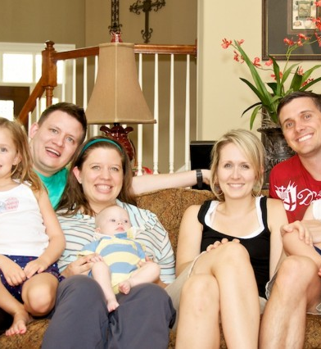
Family Preservation
LA 4685
“Children with developmental disabilities have greater opportunities for educational and social growth when they live with their families.”
- Residential Placement for Minors

